Slide 1

MACHINE LEARNING

Slide 2
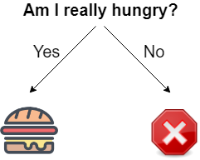
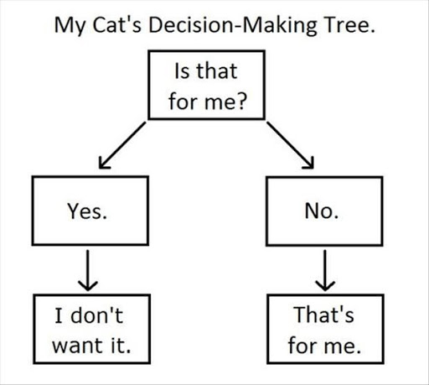
MACHINE LEARNING: WHAT IS A DECISION?
Data Squad | Machine Learning

Slide 3
MACHINE LEARNING: SHOULD I ATTEND A WEBINAR?
Organised by Ironhack?
Data Squad | Machine Learning

Slide 4
MACHINE LEARNING: SHOULD I ATTEND A WEBINAR?
Organised by Ironhack?
Yes
No
Is Pedro Speaking?
Maybe, depends

Slide 5

MACHINE LEARNING: SHOULD I ATTEND A WEBINAR?
Organised by Ironhack?
Yes
No
Is Pedro Speaking?
Maybe, depends
Yes
No
This process is an example of an algorithm
Not him again
Yes I will go!
Data Squad | Machine Learning

Slide 6
MACHINE LEARNING: WHAT IS IT?
In Machine Learning the objective is to make a prediction
Based on information, like in the previous example
BUT
The tree presented before is created in a learning process based on all the information available and on historical data points
Data Squad | Machine Learning

Slide 7
MACHINE LEARNING: WHAT IS IT?
In Machine Learning the objective is to make a prediction
Based on information, like in the previous example
BUT
The tree presented before is created in a learning process based on all the information available and on historical data points
It's the machine that learns the algorithm!
Data Squad | Machine Learning

Slide 8
MACHINE LEARNING: USECASES
Speech Recognition: to translate voice conversations into textual record
Email Prioritization: show emails by inferred importance rather than timeline
Client Segmentation and recommendation: The Next Youtube Video
Fraud Detection: Is a certain payment/transaction fraudulent?
Data Squad | Machine Learning

Slide 9
MACHINE LEARNING: SUPERVISED VS UNSUPERVISED
Whenever we have a defined output to predict it is a supervised ML problem
If we don't then we have a unsupervised learning problem
Data Squad | Machine Learning

Slide 10
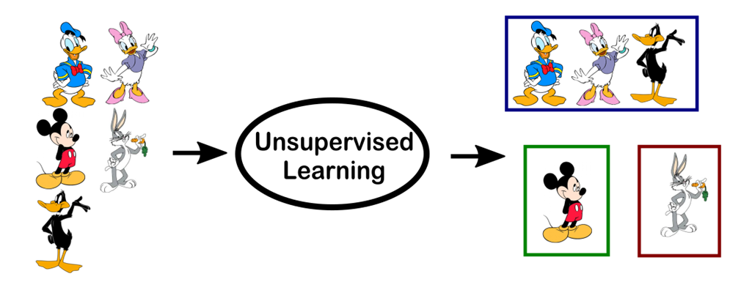
MACHINE LEARNING: SUPERVISED VS UNSUPERVISED
Data Squad | Machine Learning

Slide 11
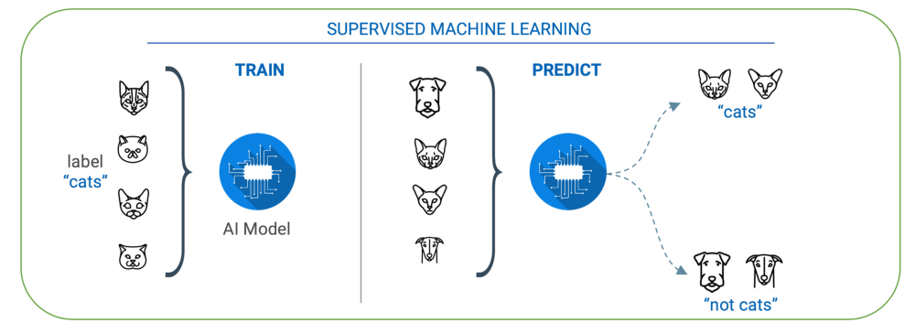
MACHINE LEARNING: SUPERVISED VS UNSUPERVISED
Data Squad | Machine Learning

Slide 12
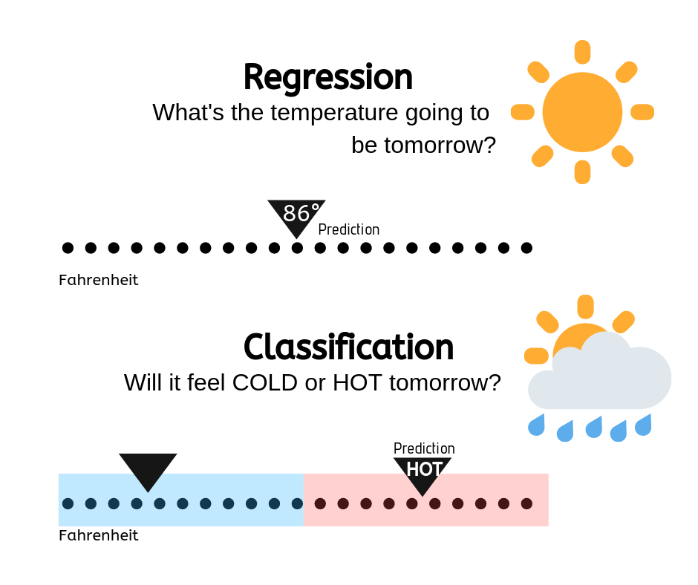
MACHINE LEARNING: TYPES OF SUPERVISED PROBLEMS
In Machine Learning a particular problem can either be a Classification or Regression problem.
The difference is in the type of variable we are trying to predict
Continuous/Numerical : Regression Problem
Categorical: Classification Problem
Data Squad | Machine Learning

Slide 13
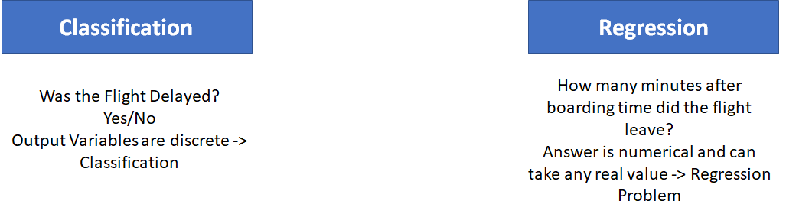
MACHINE LEARNING: EXAMPLE WALK THROUGH
Data Squad | Machine Learning

Slide 14
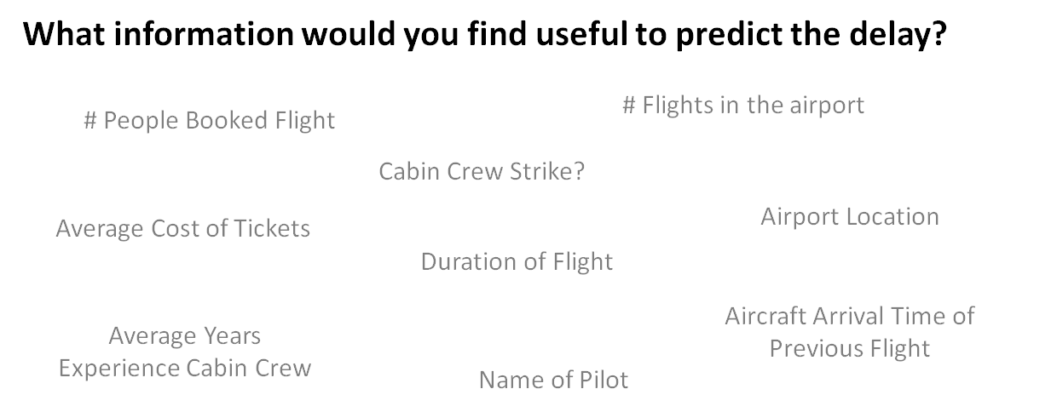
MACHINE LEARNING: EXAMPLE WALK THROUGH
Data Squad | Machine Learning

Slide 15
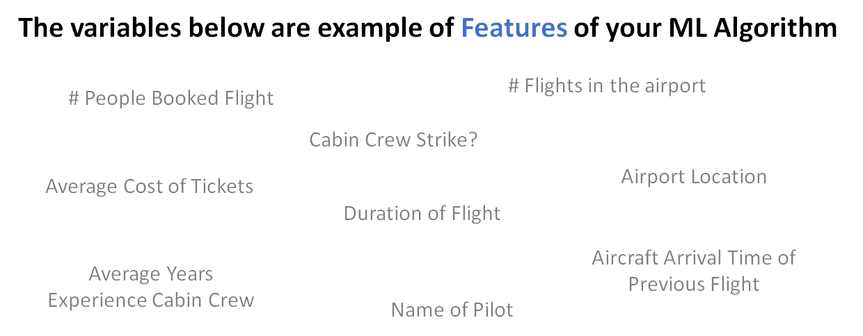
MACHINE LEARNING: EXAMPLE WALK THROUGH
Data Squad | Machine Learning

Slide 16
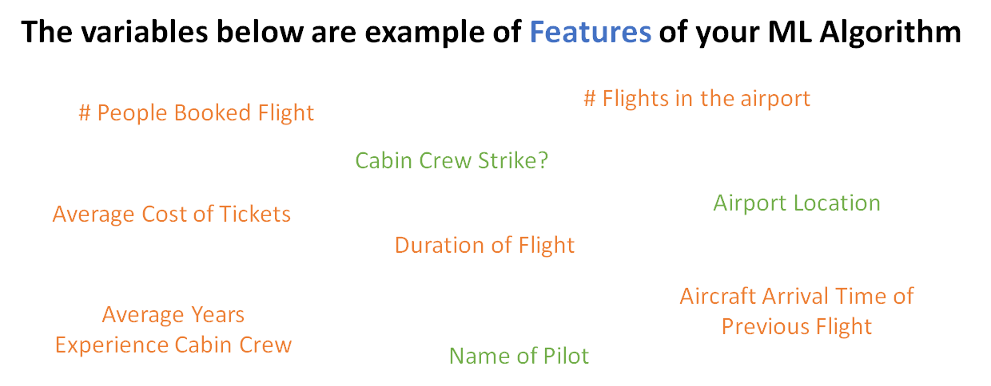
MACHINE LEARNING: EXAMPLE WALK THROUGH
Data Squad | Machine Learning

Slide 17
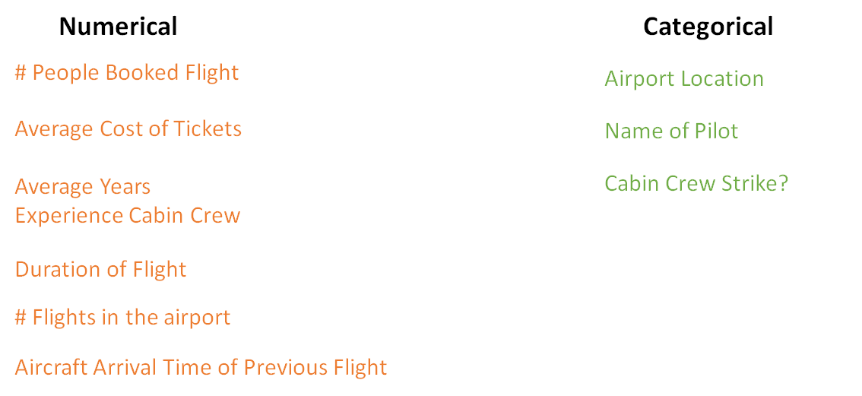
MACHINE LEARNING: EXAMPLE WALK THROUGH
Data Squad | Machine Learning

Slide 18
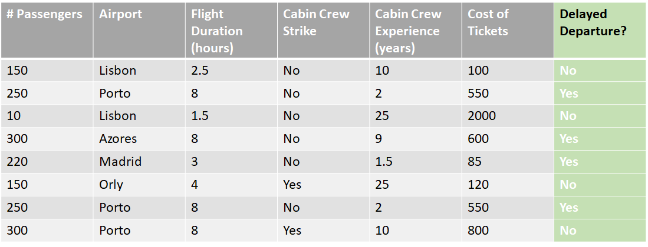
MACHINE LEARNING: EXAMPLE WALK THROUGH
Data Squad | Machine Learning

Slide 19
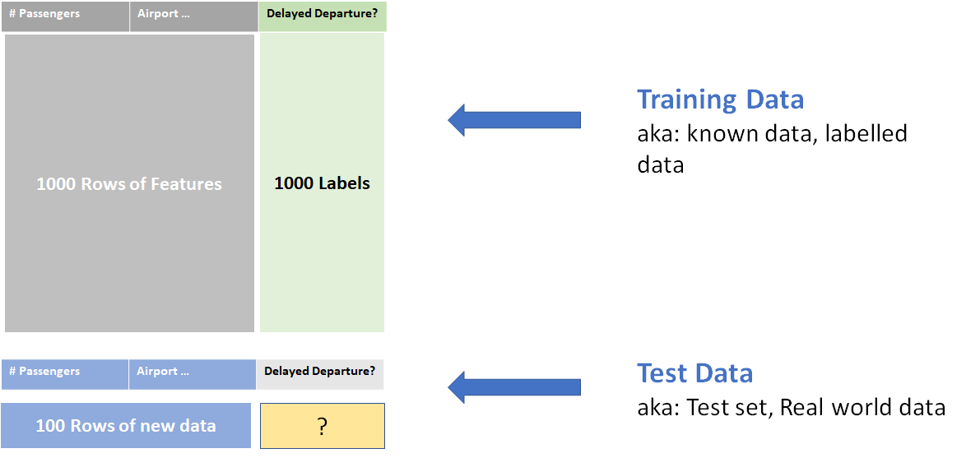
MACHINE LEARNING: EXAMPLE WALK THROUGH
Data Squad | Machine Learning

Slide 20
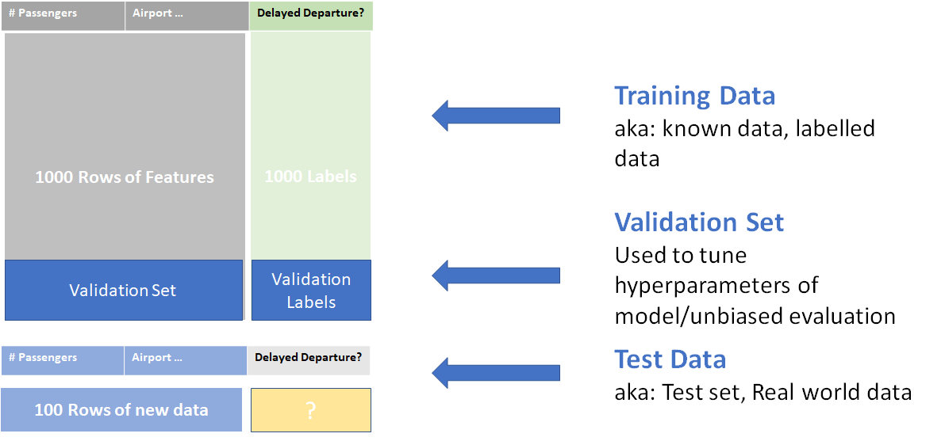
MACHINE LEARNING: EXAMPLE WALK THROUGH
Data Squad | Machine Learning

Slide 21
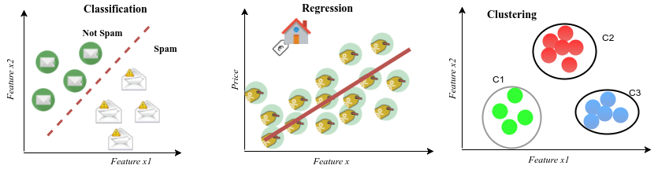
MACHINE LEARNING: A SUMMARY
Data Squad | Machine Learning

Slide 22
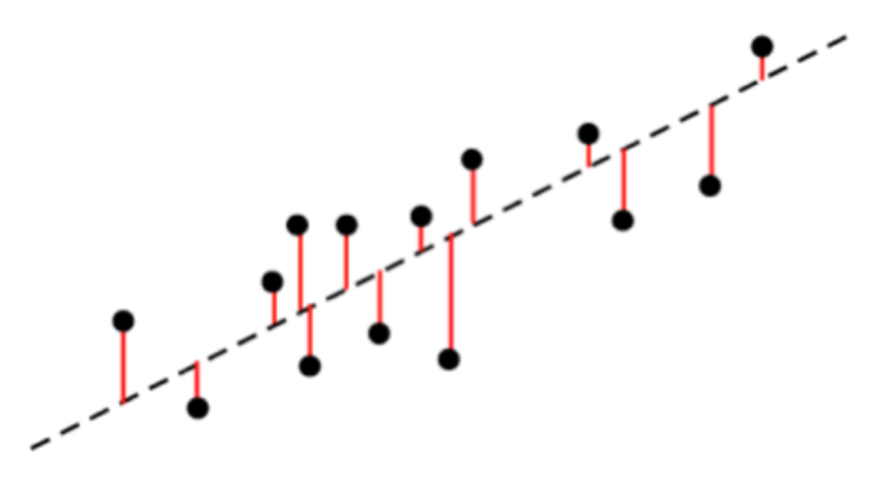

MACHINE LEARNING: HOW DO WE EVALUATE THE RESULTS?
Regression Problems
Quantify how far away our model is from data points
Data Squad | Machine Learning

Slide 23
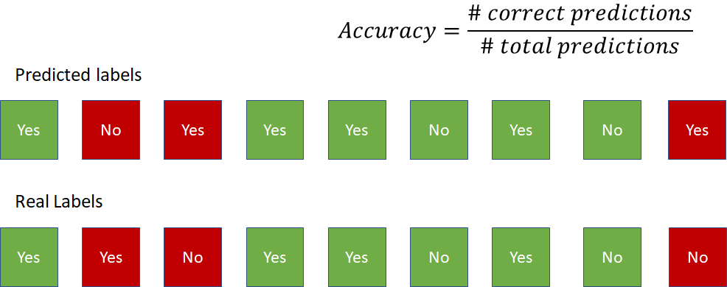
MACHINE LEARNING: HOW DO WE EVALUATE THE RESULTS?
Binary Classification Problems
Data Squad | Machine Learning

Slide 24
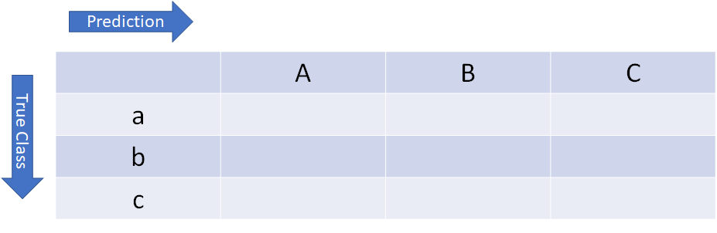
MACHINE LEARNING: HOW DO WE EVALUATE THE RESULTS?
Confusion Matrix
Data Squad | Machine Learning

Slide 25
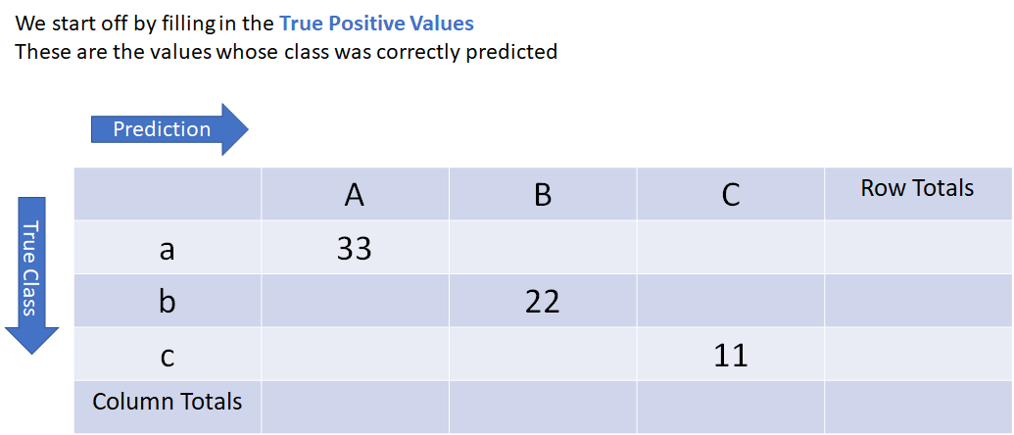
MACHINE LEARNING: HOW DO WE EVALUATE THE RESULTS?
Confusion Matrix
Data Squad | Machine Learning

Slide 26
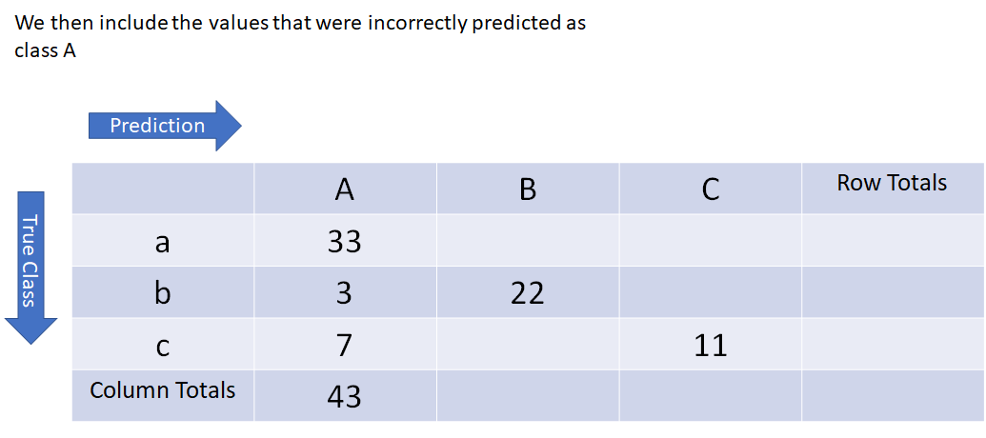
MACHINE LEARNING: HOW DO WE EVALUATE THE RESULTS?
Confusion Matrix
Data Squad | Machine Learning

Slide 27
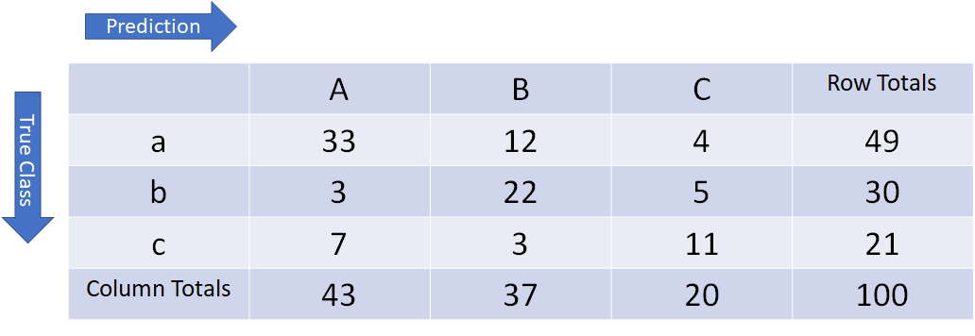
MACHINE LEARNING: HOW DO WE EVALUATE THE RESULTS?
Confusion Matrix
Data Squad | Machine Learning

Slide 28
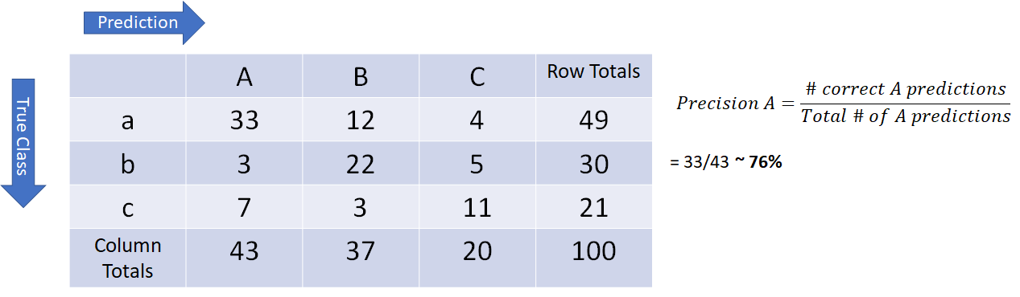
MACHINE LEARNING: HOW DO WE EVALUATE THE RESULTS?
Based on this we can define two metrics: Precision & Recall
Data Squad | Machine Learning

Slide 29
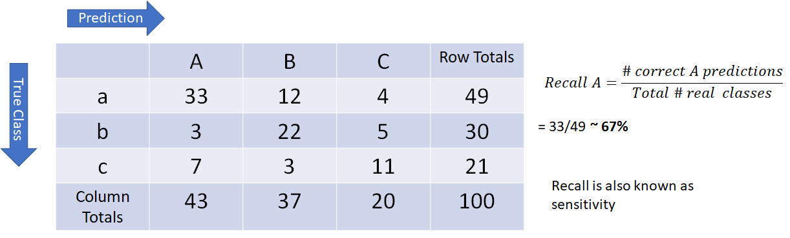
MACHINE LEARNING: HOW DO WE EVALUATE THE RESULTS?
Based on this we can define two metrics: Precision & Recall
Data Squad | Machine Learning

Slide 30
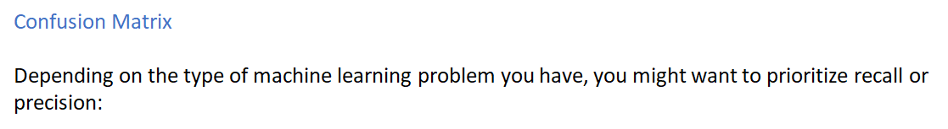
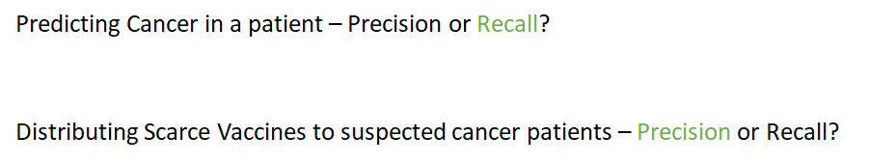
MACHINE LEARNING: HOW DO WE EVALUATE THE RESULTS?
Data Squad | Machine Learning

Slide 31
ANY QUESTIONS ?

